Slide 1
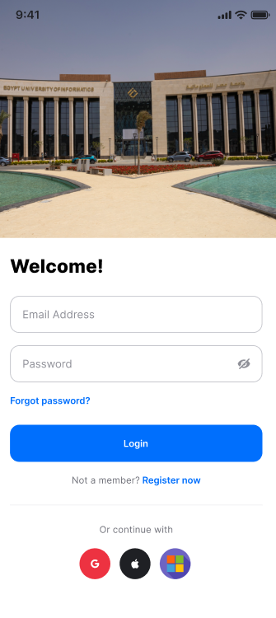
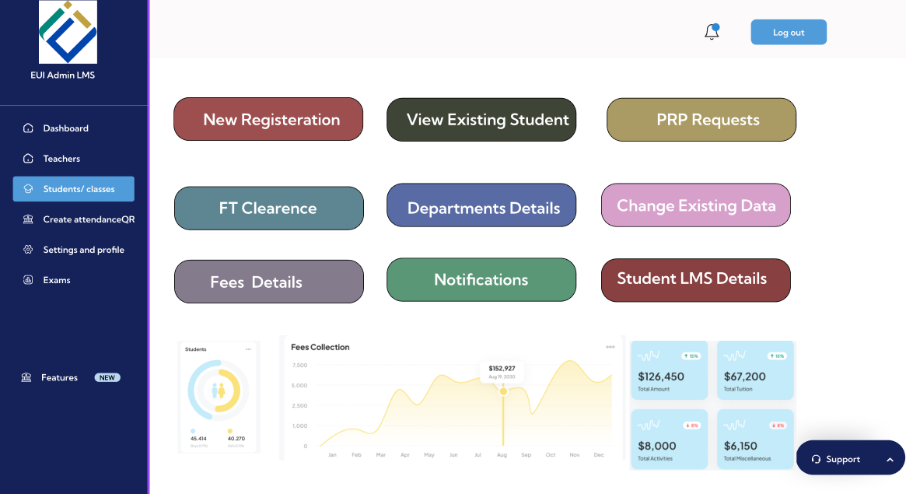
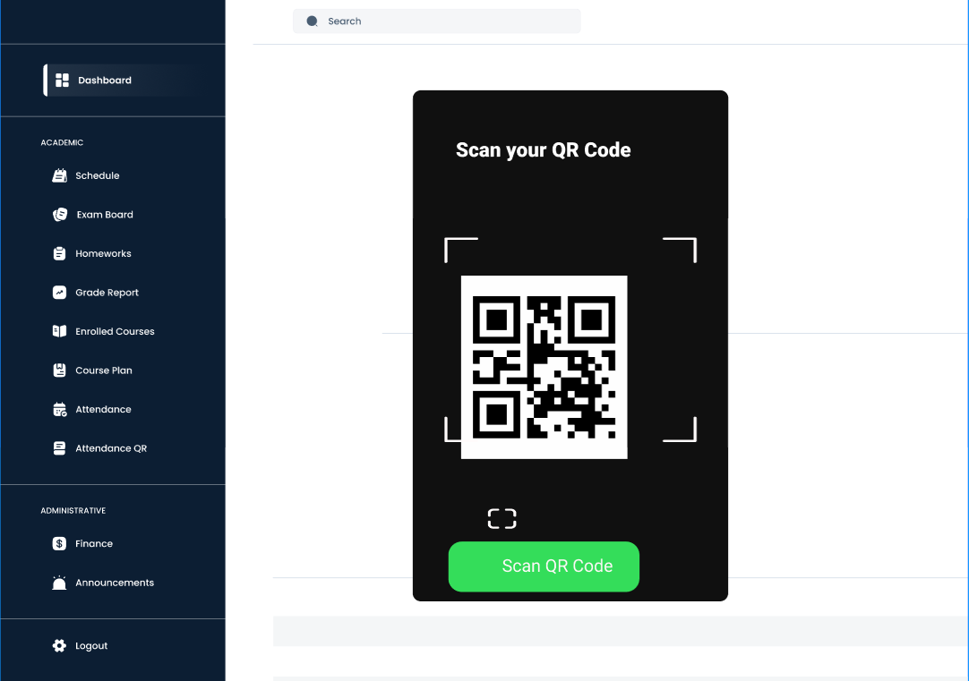
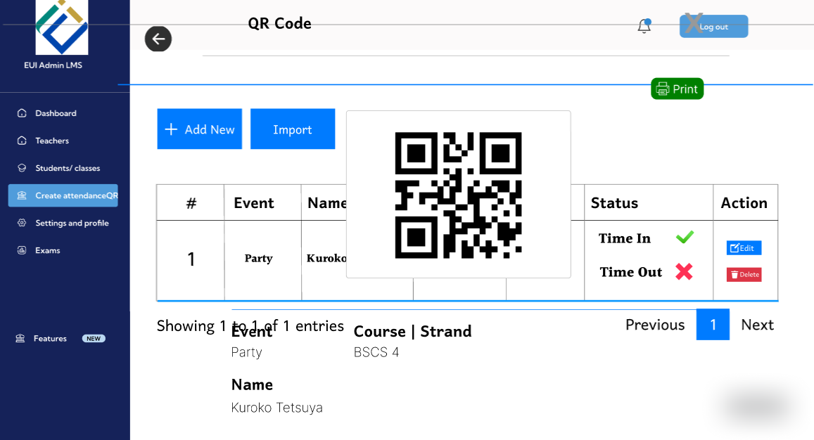
Login Via QR Code
2-
1-
4-
3-

Slide 2
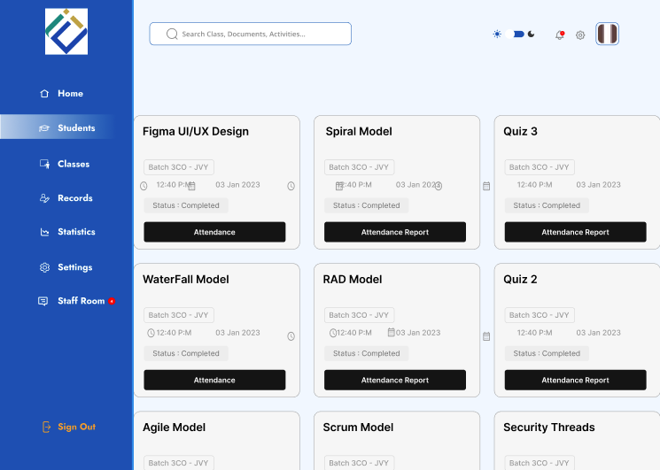
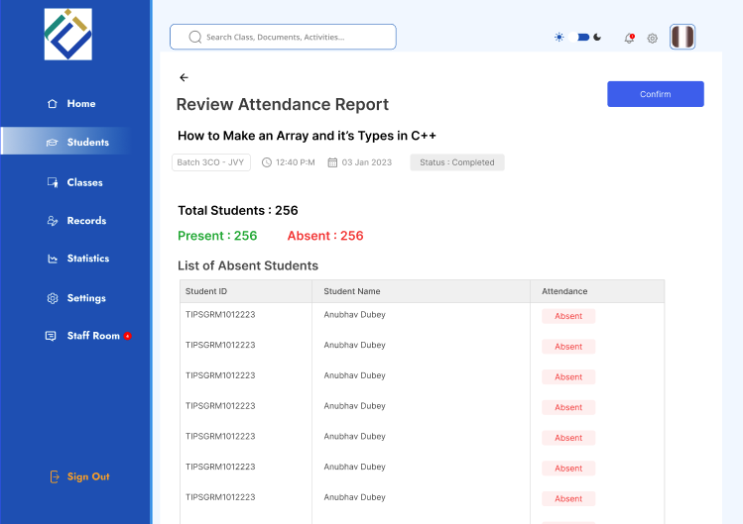
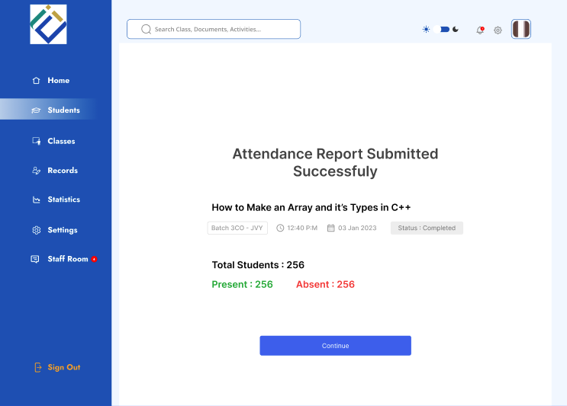
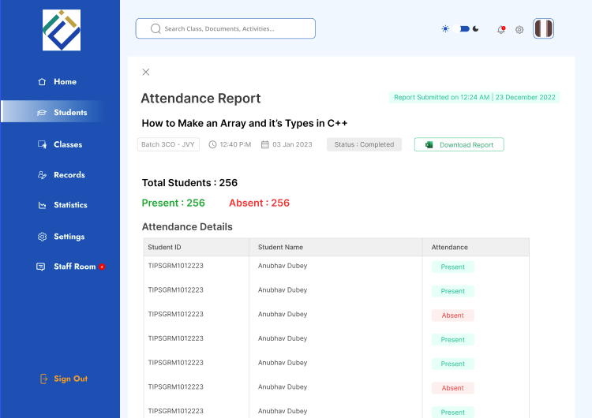
Generate attendance report& end of term report
1-
2-
3-
4-

Slide 3
Dialog for Generate attendance report& end of term report
  User: Logs into the system
  System: Displays available courses
  User: Selects a course
  System: Shows attendance summary and student list
  User: Reviews attendance data
  User: Confirms attendance report
  System: Displays submission success message
  User: Continues to final report
  System: Displays final attendance details
  User: Downloads attendance / end-of-term report
  System: Generates and downloads the report

Slide 4
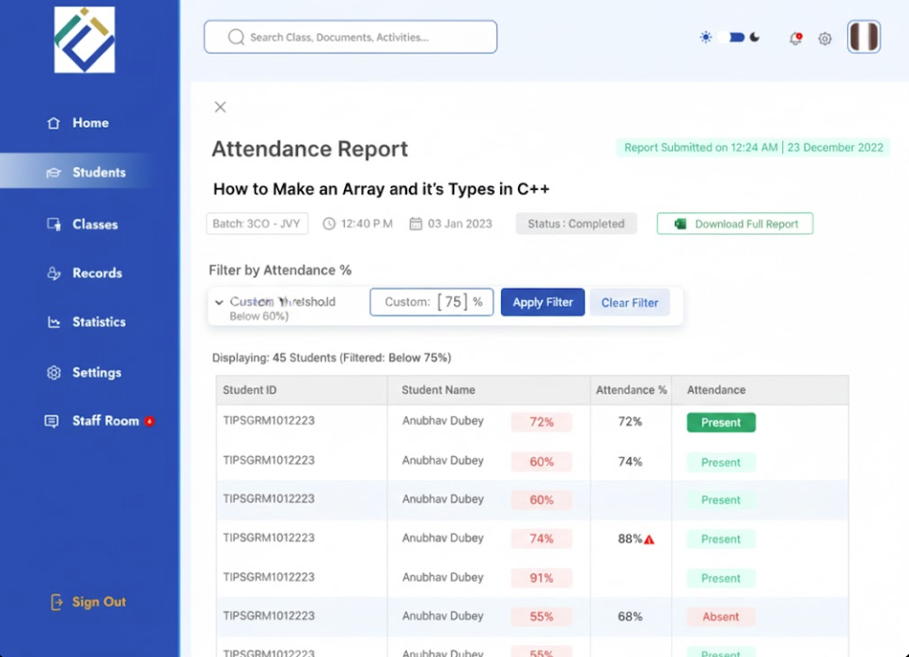
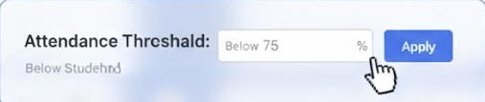

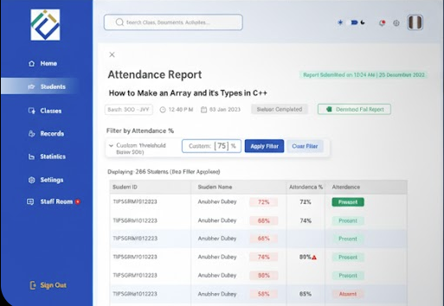
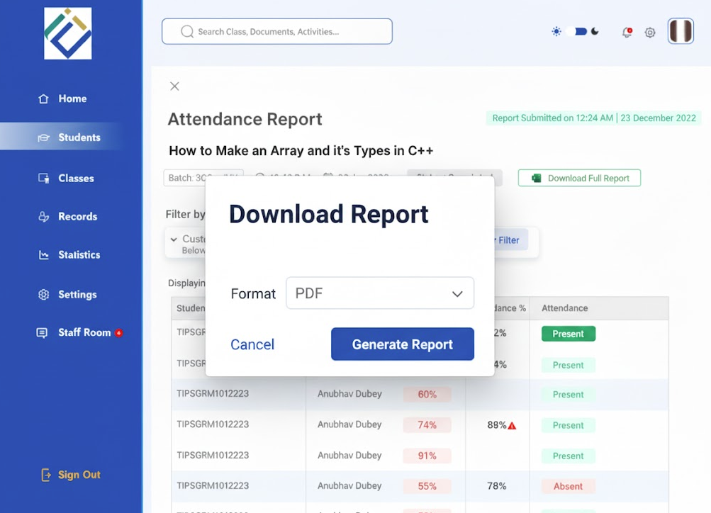
Generate at risk students
1-
2-
4-
3-

Slide 5
Generate at risk students
User: Opens attendance list
System: Displays attendance data
User: Sets attendance threshold (below 75% or 60%)
User: Clicks Apply
System: Filters and displays at-risk students
User: Reviews filtered list
User: Clicks Download Report
System: Shows report format options
User: Selects PDF and confirms
System: Generates and downloads the at-risk students report

Slide 6
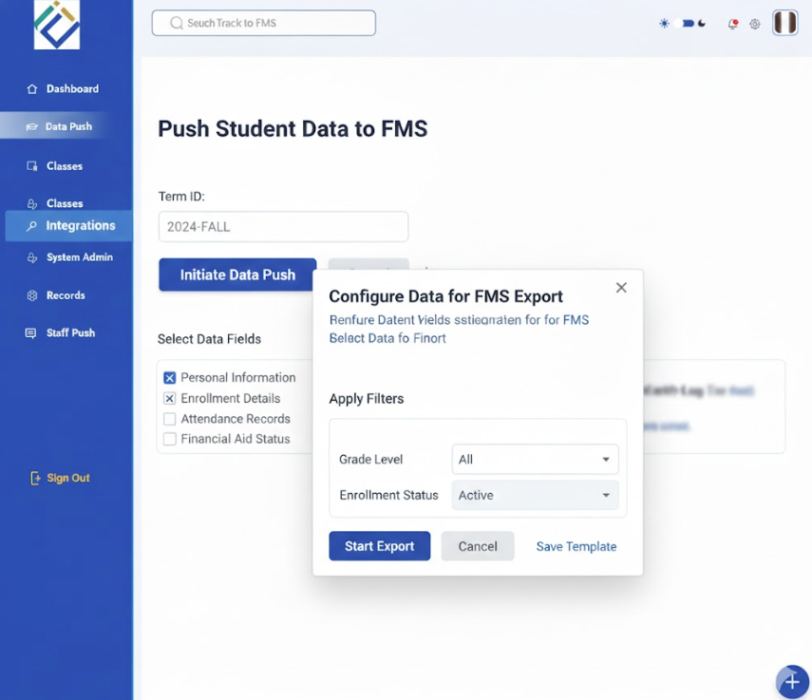
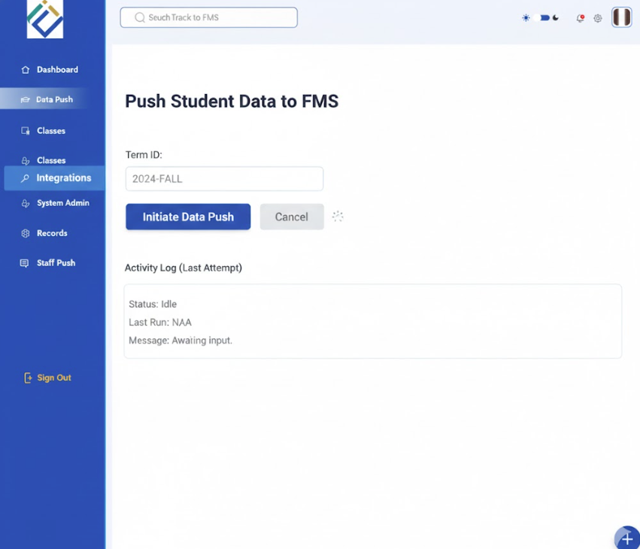
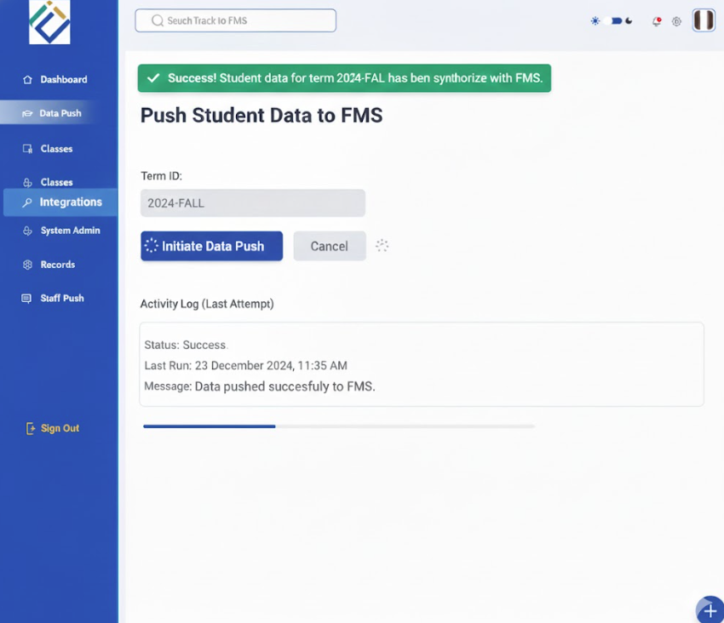
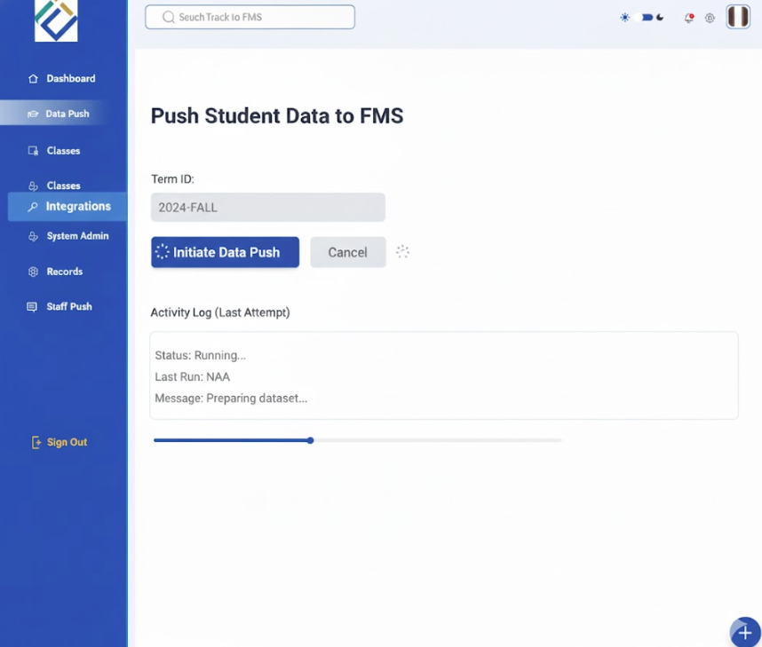
Push data to FMS
1-
2-
4-
3-

Slide 7
Push data to FMS
User: Opens Push Student Data to FMS
System: Displays term, course, and data options
User: Selects course and required data fields
User: Applies export filters
User: Clicks Initiate Data Push
System: Validates selected data
System: Prepares dataset
System: Pushes data to FMS
System: Displays success message

